Slide 1
UCS: The Underwriting Criteria Scoring Tool
Pete Miller, ASA, MAAA
Chicago Actuarial Association
Wednesday, March 23, 2016

Slide 2
Agenda
Summary
Background
Spreadsheet: Underwriting Scoring Tool (UST)
Online: Relative Risk Tool (RRTool)
Applications
Demonstration
Questions & Answers

Slide 3
Summary and Background

Slide 4
Summary
The Underwriting Criteria Scoring (UCS) tool is an integral part of the new Principles Based Reserving methodology.
This session will report on recent activity, including a preview of the online version that is being developed.

Slide 5
Background
VBT Tables
RR Values with 2008 VBT
Actuary needs to assign RR table that matches preferred class structure.

Slide 6
Underwriting Scoring Tool (UST)
A spreadsheet.
Created to match underwriting criteria to RR score to select RR table.
Based on 8 underwriting criteria and how a plan/structure stacks up against typical results. (Labs, etc.)

Slide 7
Relative Risk Tool (RRTool)
Online version of the spreadsheet.
Provides neat, organized front for input and storage of entered structures.
Entered criteria:
Blood Pressure.
Build.
Cholesterol.
Driving Record.
Family Medical History.
Personal Medical History.
Substance Abuse.
Other.

Slide 8
Applications

Slide 9
Four Class Base Case Results
The primary criteria for the class structure:
Additionally, the class structure is based on:
Driving Record (Moving Violations and DUI/RD)
Family Medical History
Personal Medical History
Substance Abuse (Alcohol and Drug Use)
 |  |  |  | Cholesterol | Total
Class | Blood Pressure |  | Build - BMI | Ratio | Cholesterol | Results
Base
 |  |  |  |  |  | UCST |  |  | ILEC
 | Systolic | Diastolic |  |  |  | Results |  |  | Results
1 | 0 - 130 | 0 - 80 | 18.5 - 27.4 | 0 - 5.0 | 0 - 275 | 82.6% |  |  | 75.6%
2 | 130 - 135 | 80 -85 | 27.4 - 30.9 | 5.0 - 6.0 | 275 - 300 | 91.3% |  |  | 98.2%
3 | 135 - 145 | 85 - 90 | 30.9 - 33.5 | 6.0 - 6.5 | 300+ | 118.6% |  |  | 113.7%
4 | 145+ | 90+ | 0 - 18.5 and 33.5+ | 6.5+ | 300+ | 140.5% |  |  | 135.4%

Slide 10
Three Class Base Case Results
The primary criteria for the class structure:
Additionally, the class structure is based on:
Driving Record (Moving Violations and DUI/RD)
Family Medical History
Personal Medical History
Substance Abuse (Alcohol and Drug Use)
 |  |  |  |  | Cholesterol | Total
Class | Blood Pressure |  | Build - BMI |  | Ratio | Cholesterol | Results
Base
 |  |  |  |  |  |  | UCST |  |  | ILEC
 | Systolic | Diastolic | Male | Female |  |  | Current |  |  | Results
1 | 0 - 130 | 0 - 85 | 0 - 28.5 | 0 - 25.8 | 0 - 5.0 | 0 - 230 | 75.3% |  |  | 78.8%
2 | 130 - 135 | 85 - 90 | 28.5 - 30.9 | 25.8 - 27.8 | 5.0 - 6.0 | 230 - 250 | 95.0% |  |  | 92.6%
3 | 135+ | 90+ | 30.9+ | 27.8+ | 6.0+ | 250+ | 120.1% |  |  | 126.3%

Slide 11
Demonstration

Slide 12
Opening Screen

Slide 13
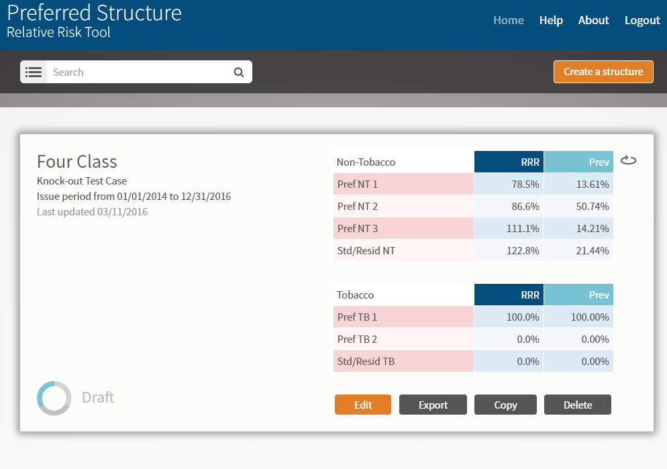
Top Screen

Slide 14
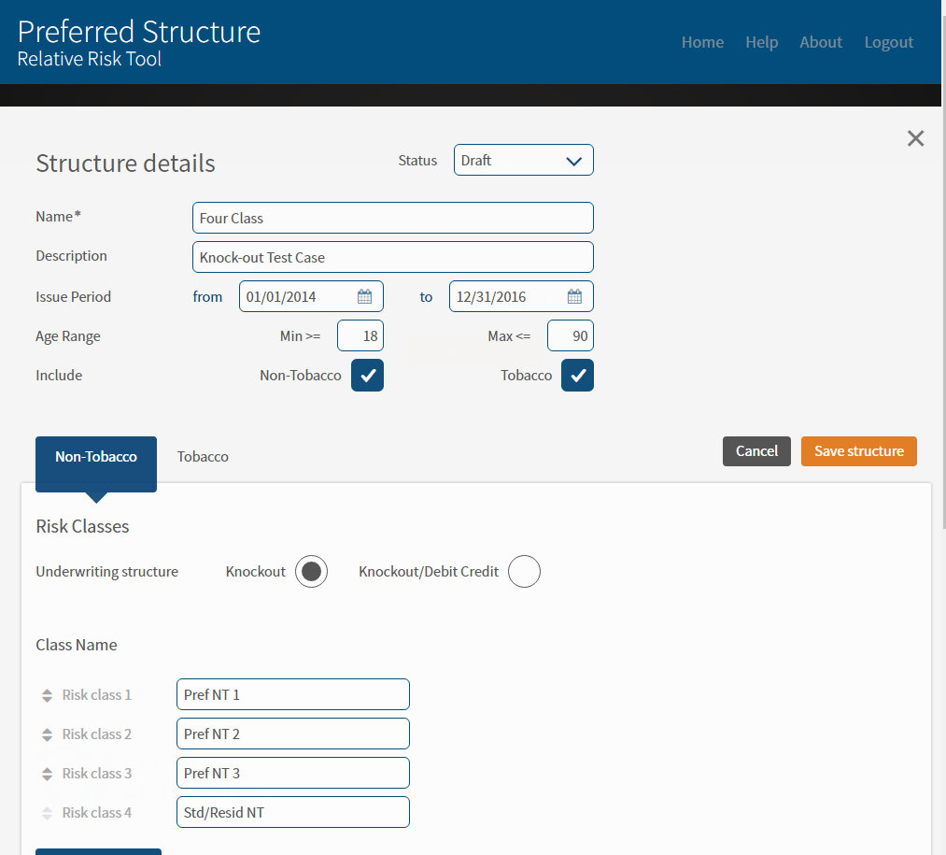
Structure Information

Slide 15
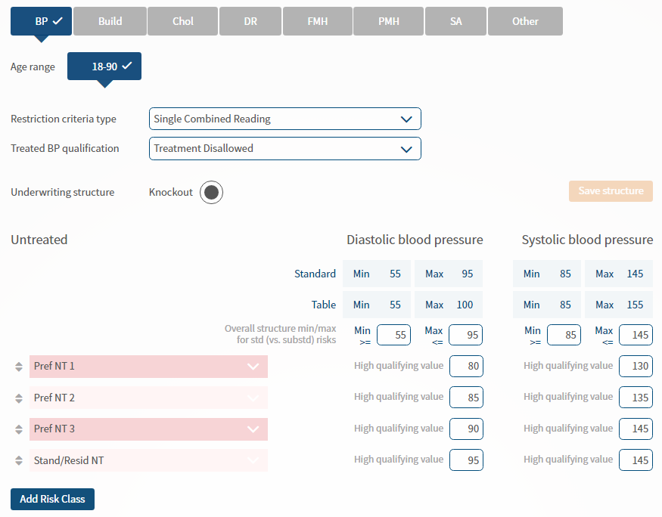
Blood Pressure

Slide 16
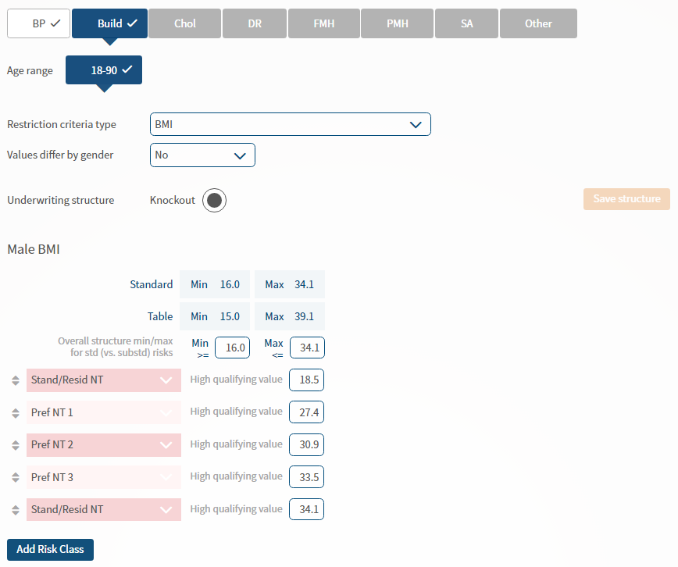
Build

Slide 17
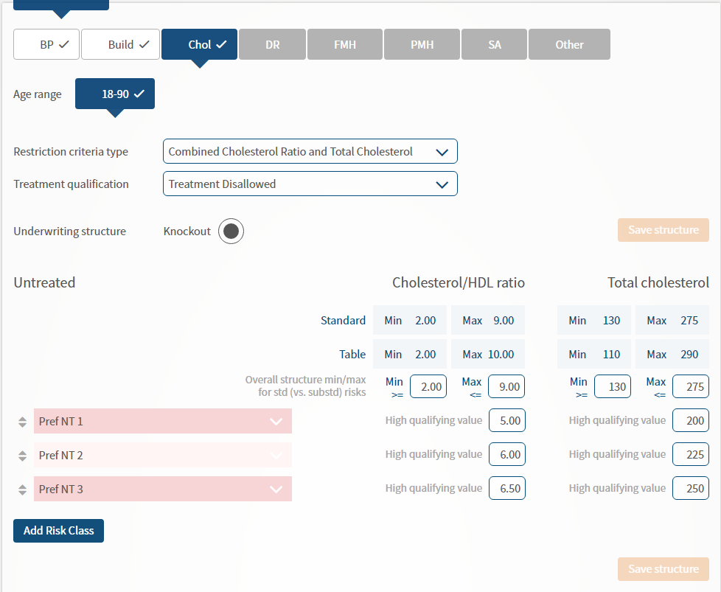
Cholesterol

Slide 18
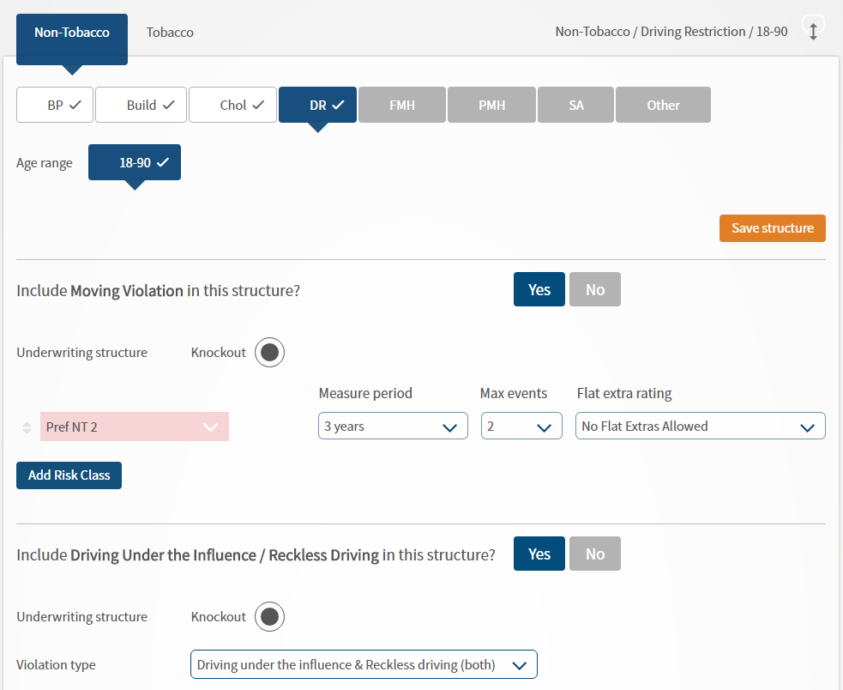
Driving Record

Slide 19
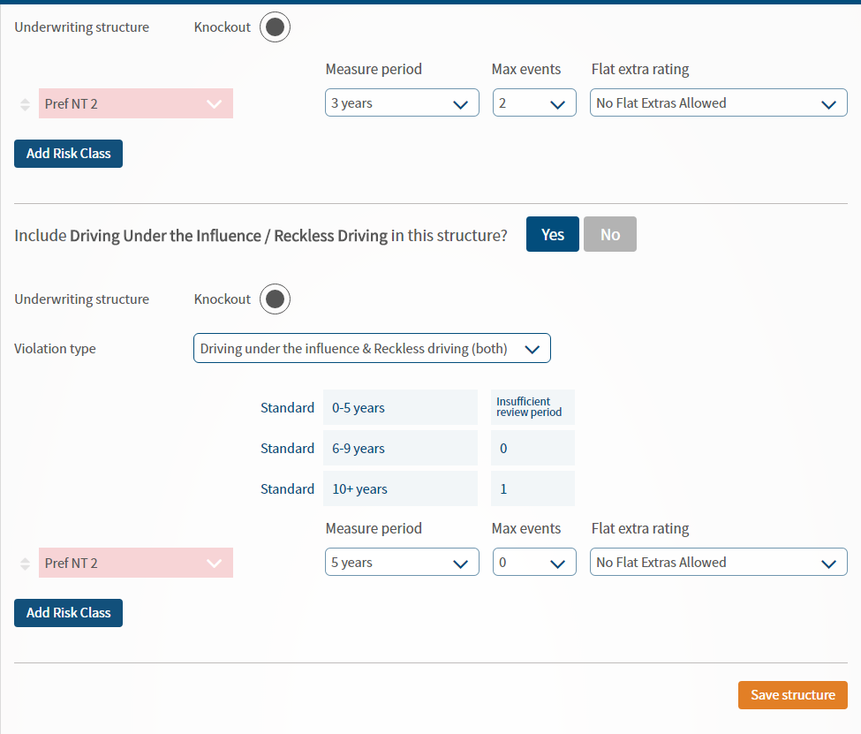
Driving Record (Continued)

Slide 20
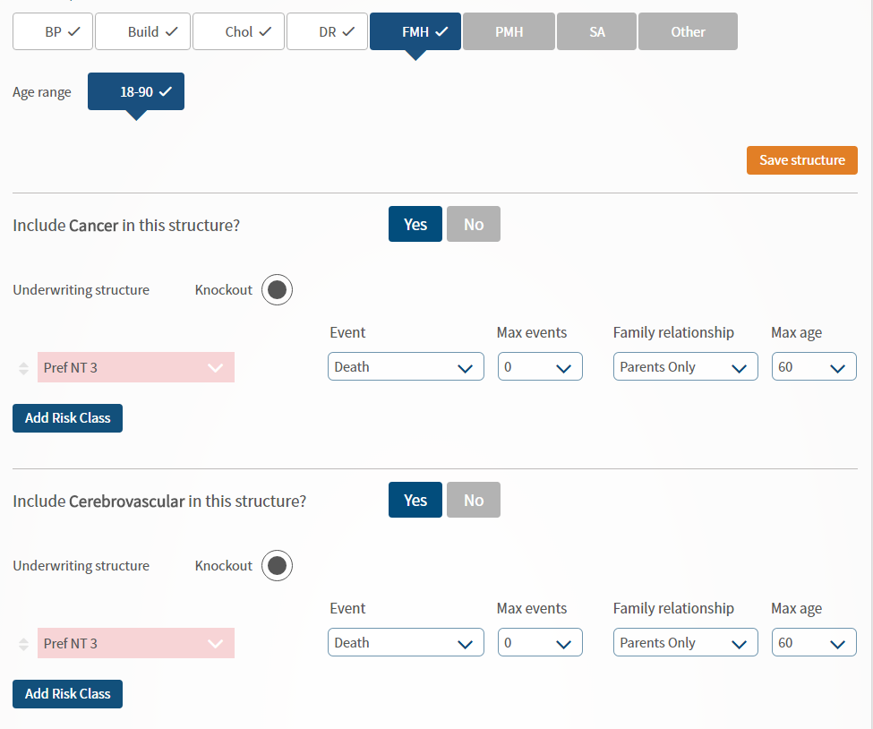
Family Medical History

Slide 21
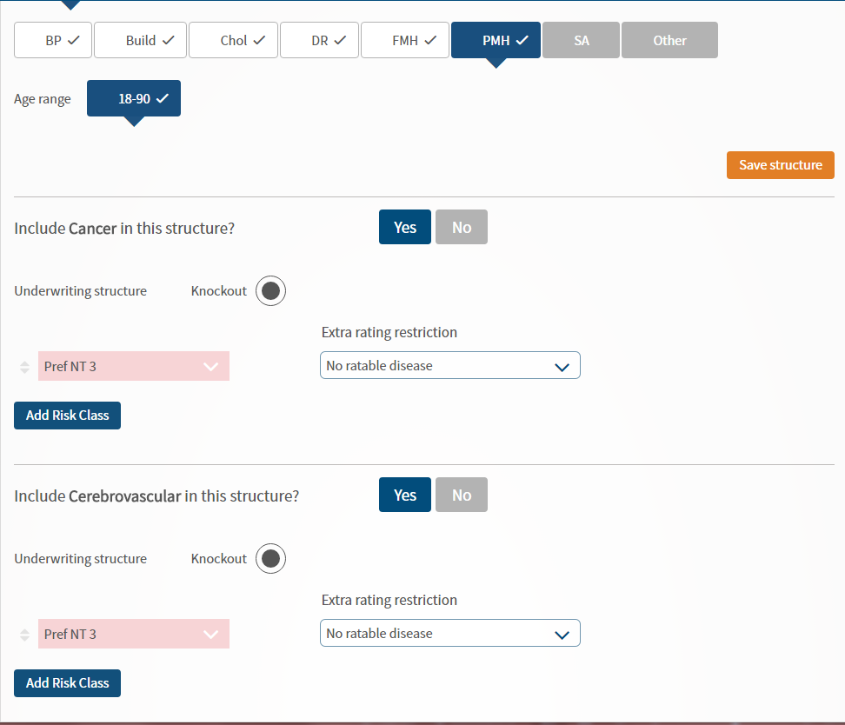
Personal Medical History

Slide 22
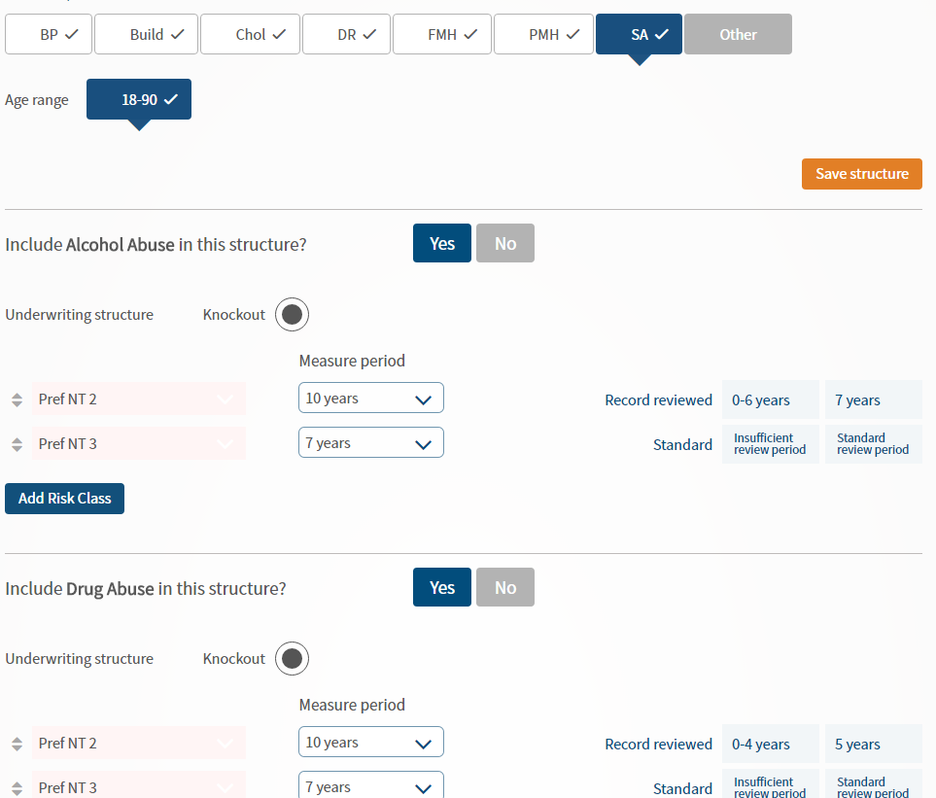
Substance Abuse

Slide 23
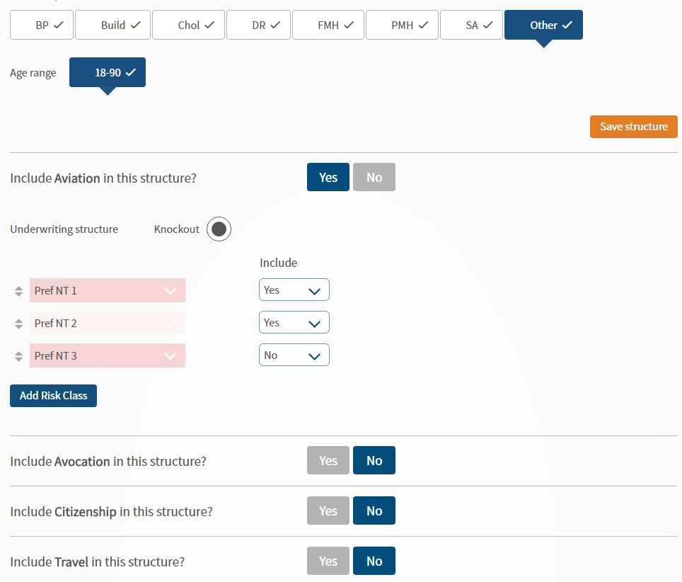
Other

Slide 24
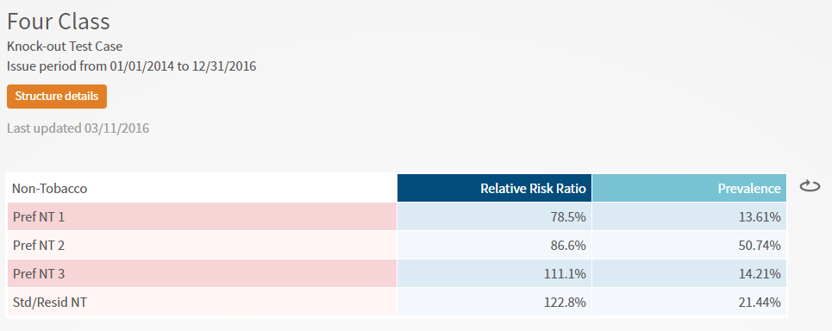
Results Display

Slide 25
Questions and Answers

